Slide 1
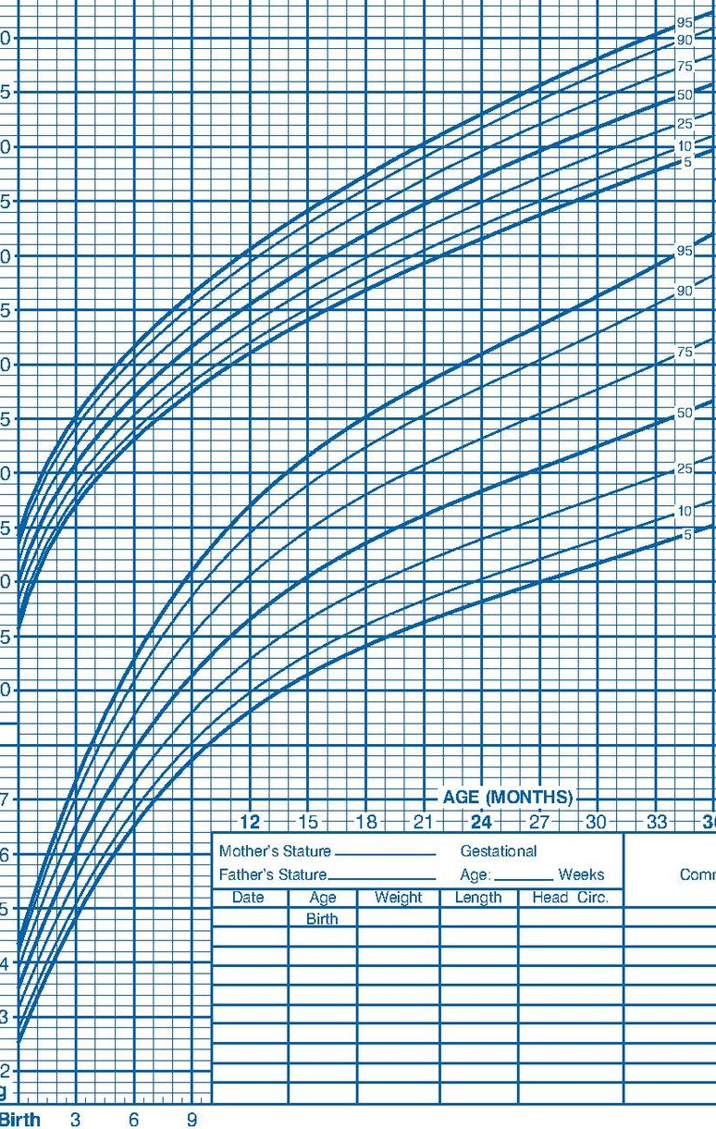
1. Ideas
2. Filter
Systolic (percentile)
Systolic (percentile)
Systolic (percentile)
Age
Systolic
Diastolic (percentile)
Diastolic (percentile)
Diastolic (percentile)
Blood pressure
Diastolic
Systolic
Systolic
Diastolic
Systolic (percentile)
Age
Age
Diastolic
Age
Age
Diastolic (percentile)
Blood pressure (percentile)
Blood pressure (percentile)
3. Categorize
2D scatter plot
Show patient’s data over time for comparison/trend
Age
Systolic (percentile)
Diastolic (percentile)
Systolic
Blood pressure
Diastolic
Age
5. Question
4. Combine and Refine
Answer blood pressure trends over time
Only for one specific patient
Switch axes (BP on y and age on x)
Brush selection of systolic and diastolic (take it easier to see them separately)
Include horizontal lines for cutoffs
95th, 99th %iles
95th %ile + 12 mmHg
Instead of blood pressure percentiles, display in terms of hypertension cutoffs to allow for continuity from pedi to adult cutoffs?
Systolic
Age
Diastolic
Blood pressure (percentile)
Also add growth chart-adaptation for familiarity of interpretation?

Slide 2
Layout
Title:
Author:
Date:
Sheet: 2
Task:
Operations
Focus
Discussion

Slide 3
Layout
Title:
Author:
Date:
Sheet: 3
Task:
Operations
Focus
Discussion

Slide 4
Layout
Title:
Author:
Date:
Sheet: 4
Task:
Operations
Focus
Discussion

Slide 5
Layout
Title:
Author:
Date:
Sheet: 5
Task:
Operations
Focus
Detail

